Slide 1



Permissions & Content Providers

Slide 2
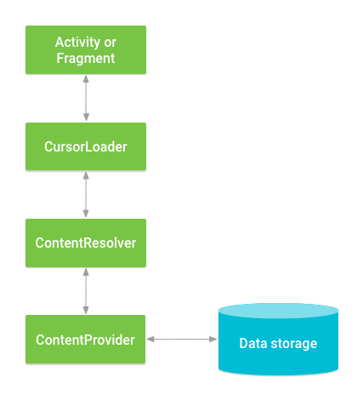
Introduction
Permissions must be declared in the Manifest.xml.
Each app can have it is own content provider.
Content provider can be shared with the other apps.
Examples:
Message app have the messages in the content provider. Other apps can access the messages through this content provider.
Same as the contact in the contacts app.
~Courtesy: developer.android.com

Slide 3
ConstraintLayout
The app database is an SQLiteDatabase to store the content.
We can access other apps contents providers.
We can create a content provider for an app.
App2
App1
Content Provider
Query
Activity
Insert
Update
Delete
App Database

Slide 4

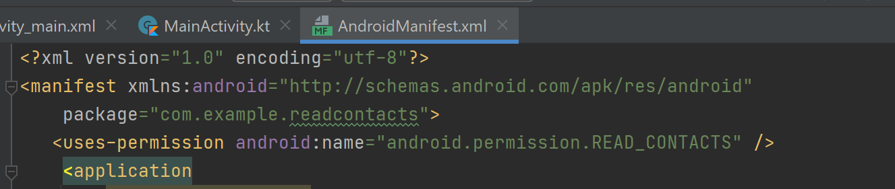
Read Contacts contents
Create a new app -> Empty Activity.
with the name contactsReader.
open AndroidManifest.xml
Add the following permission:
<uses-permission android:name="android.permission.READ_CONTACTS" />

Slide 5
imports
import android.content.pm.PackageManager import android.os.Build import androidx.appcompat.app.AppCompatActivity import android.os.Bundle import android.provider.ContactsContract import android.widget.ListView import android.widget.SearchView import android.widget.SearchView.OnQueryTextListener import android.widget.SimpleCursorAdapter import android.widget.Toast import androidx.annotation.RequiresApi import androidx.core.app.ActivityCompat

Slide 6
MainActivity.kt
package com.example.contactreader import .. class MainActivity : AppCompatActivity() { override fun onCreate(savedInstanceState: Bundle?) { super.onCreate(savedInstanceState) setContentView(R.layout.activity_main) if (ActivityCompat.checkSelfPermission( this, android.Manifest.permission.READ_CONTACTS ) != PackageManager.PERMISSION_GRANTED) { ActivityCompat.requestPermissions(this, Array(1){android.Manifest.permission.READ_CONTACTS},111) } else readcontacts() } private fun readcontacts() { TODO("Not yet implemented") } }
ActivityCompat.checkSelfPermission() Takes 2 parameters:
The context where this means this layout.
Permission: which permission.
It returns: PackageManager.PERMISSION_GRANTED
Or
PackageManager.PERMISSION_DENIED
ActivityCompat.requestPermissions() prompts the user to allow access to specific context, array of permissions, return code (111, in this case).

Slide 7
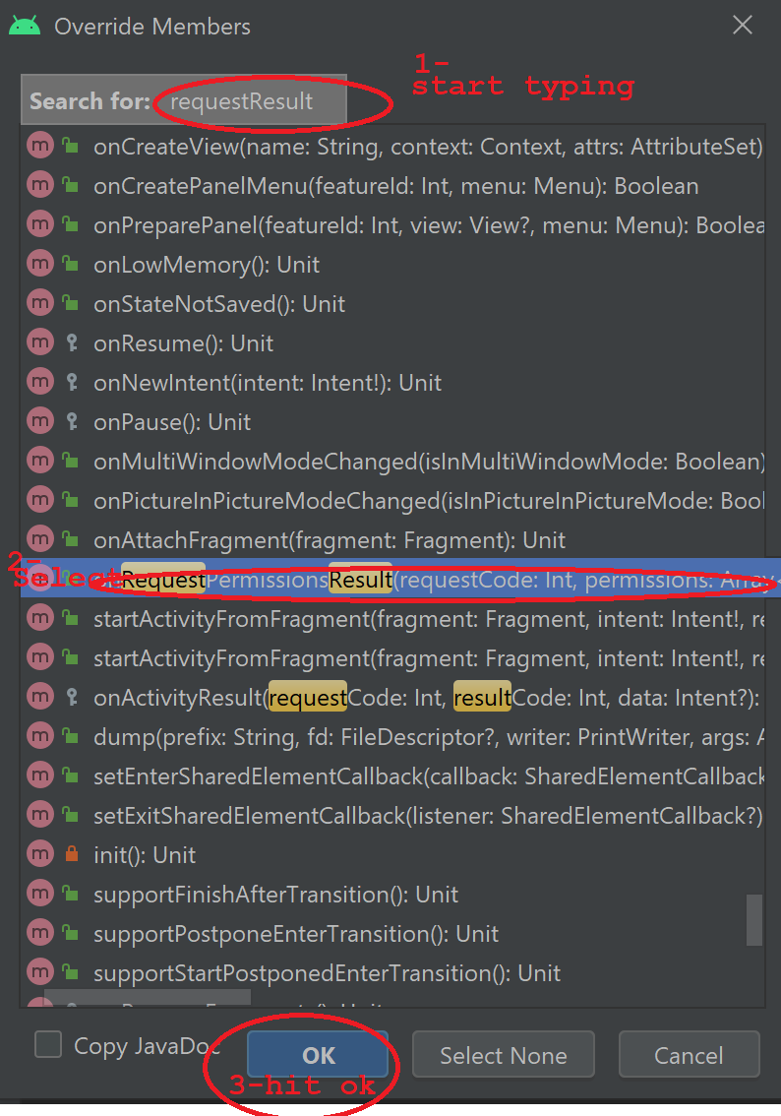
package com.example.contactreader import .. class MainActivity : AppCompatActivity() { override fun onCreate(savedInstanceState: Bundle?) { super.onCreate(savedInstanceState) setContentView(R.layout.activity_main) if (ActivityCompat.checkSelfPermission( this, android.Manifest.permission.READ_CONTACTS ) != PackageManager.PERMISSION_GRANTED) { ActivityCompat.requestPermissions(this, Array(1){android.Manifest.permission.READ_CONTACTS},111) } else readcontacts() } private fun readcontacts() { TODO("Not yet implemented") } }
Click Cntrl+O

Slide 8
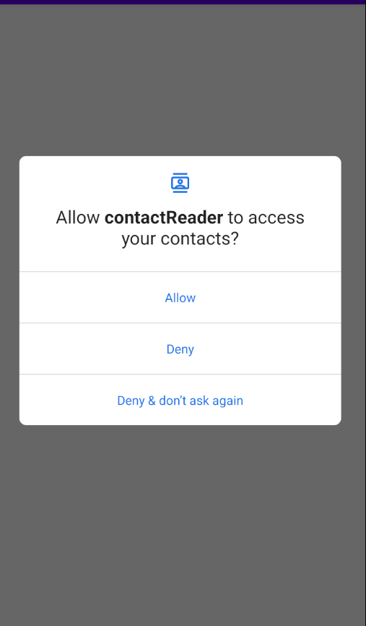
onRequestPermissionsResult
override fun onRequestPermissionsResult( requestCode: Int, permissions: Array<out String>, grantResults: IntArray ) { if(requestCode == 111 && grantResults[0]==PackageManager.PERMISSION_GRANTED) { readcontacts() } }

Slide 9
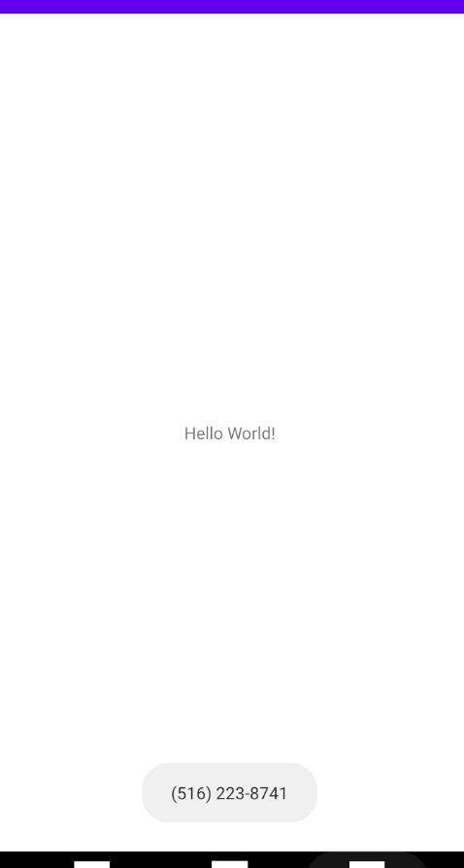
Implementing readcontacts()
val cols = listOf<String>(ContactsContract.CommonDataKinds.Phone.DISPLAY_NAME, ContactsContract.CommonDataKinds.Phone.NUMBER, ContactsContract.CommonDataKinds.Phone._ID ).toTypedArray() private fun readcontacts() { var rs = contentResolver.query(
ContactsContract.CommonDataKinds.Phone.CONTENT_URI ,
cols, null, null, cols[0] ) if (rs?.moveToNext() == true) Toast.makeText(applicationContext,rs.getString(1),Toast.LENGTH_SHORT).show() }
URI
Columns to show
Selection Args
Selection: Condition to filter the query
Sorting

Slide 10
Activity_main.xml
<?xml version="1.0" encoding="utf-8"?>
<androidx.constraintlayout.widget.ConstraintLayout xmlns:android="http://schemas.android.com/apk/res/android"
xmlns:app="http://schemas.android.com/apk/res-auto"
xmlns:tools="http://schemas.android.com/tools"
android:layout_width="match_parent"
android:layout_height="match_parent"
tools:context=".MainActivity">
<SearchView
android:id="@+id/searchViewContacts"
android:layout_width="match_parent"
android:layout_height="wrap_content"
app:layout_constraintBottom_toBottomOf="parent"
app:layout_constraintEnd_toEndOf="parent"
app:layout_constraintHorizontal_bias="0.0"
app:layout_constraintStart_toStartOf="parent"
app:layout_constraintTop_toTopOf="parent"
app:layout_constraintVertical_bias="0.058" />
<ListView
android:id="@+id/listViewContacts"
android:layout_width="409dp"
android:layout_height="641dp"
android:layout_marginTop="32dp"
app:layout_constraintBottom_toBottomOf="parent"
app:layout_constraintEnd_toEndOf="parent"
app:layout_constraintStart_toStartOf="parent"
app:layout_constraintTop_toBottomOf="@+id/searchView" />
</androidx.constraintlayout.widget.ConstraintLayout>

Slide 11
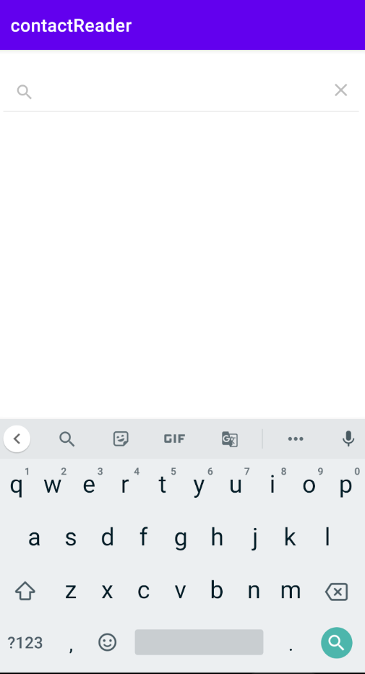
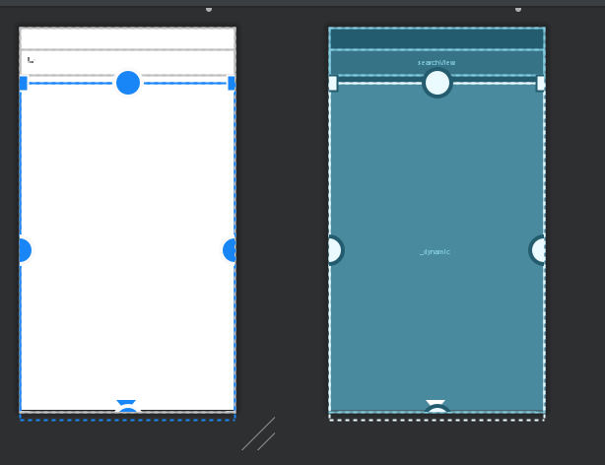
Activity_main.xml

Slide 12
Adjust readContacts()
private fun readcontacts() { var from = listOf<String>(cols[0],cols[1]).toTypedArray() var to = intArrayOf(android.R.id.text1,android.R.id.text2) var rs = contentResolver.query(ContactsContract.CommonDataKinds.Phone.CONTENT_URI ,
cols, null, null, cols[0] ) var adapter = SimpleCursorAdapter(this, android.R.layout.simple_list_item_2, rs, from, to, 0) val contractLV: ListView = findViewById(R.id.listViewContacts) contractLV.adapter = adapter }
Context
Style
Result of the query
Specific columns
flag
Style of the adapter columsn

Slide 13
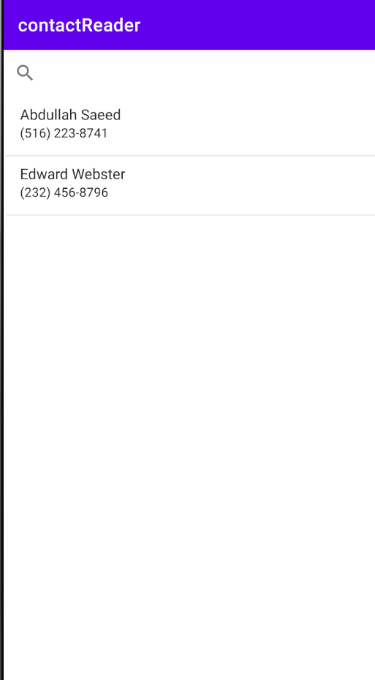
Missing something??
Try to search!!!

Slide 14
In readContacts()
contractLV.adapter = adapter val contractSV : SearchView = findViewById(R.id.searchViewContacts) contractSV.setOnQueryTextListener(object : SearchView.OnQueryTextListener { override fun onQueryTextChange(q: String): Boolean { return false } override fun onQueryTextSubmit(q: String): Boolean { return false } })

Slide 15
Changing the selection and selectionArgs
override fun onQueryTextChange(q: String): Boolean { var rs = contentResolver.query(ContactsContract.CommonDataKinds.Phone.CONTENT_URI , cols, "${cols[0]} LIKE ?", Array(1){"%$q%"}, cols[0]) adapter.changeCursor(rs) return false }

Slide 16
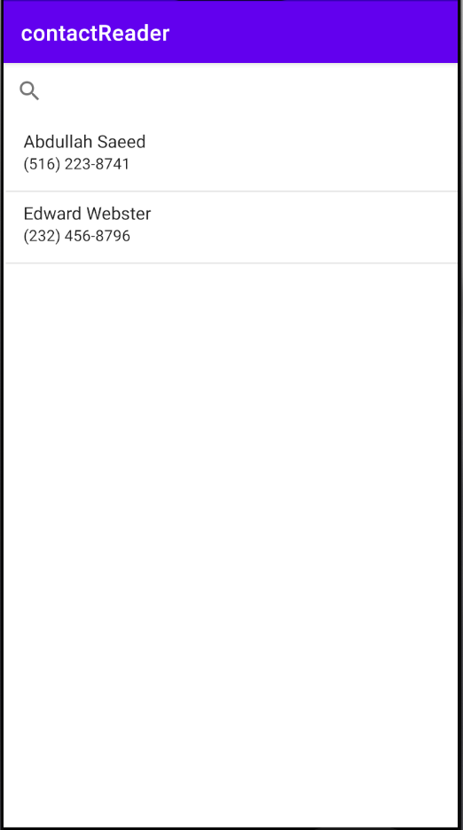
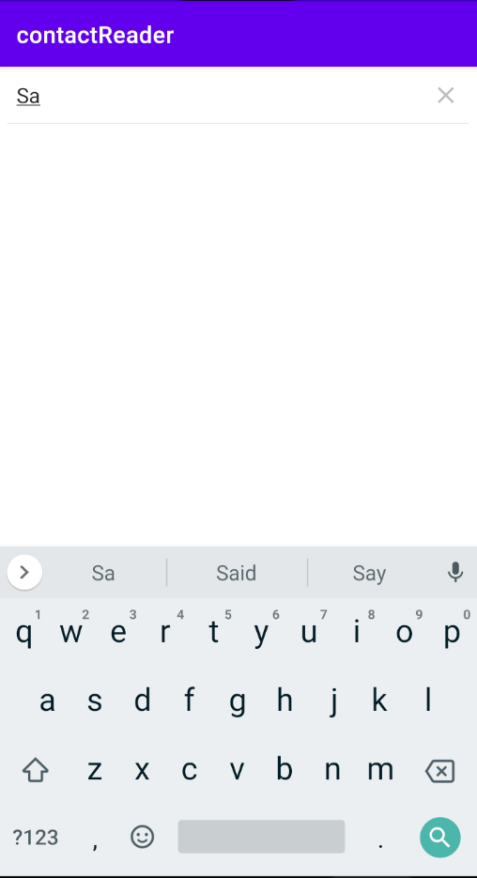
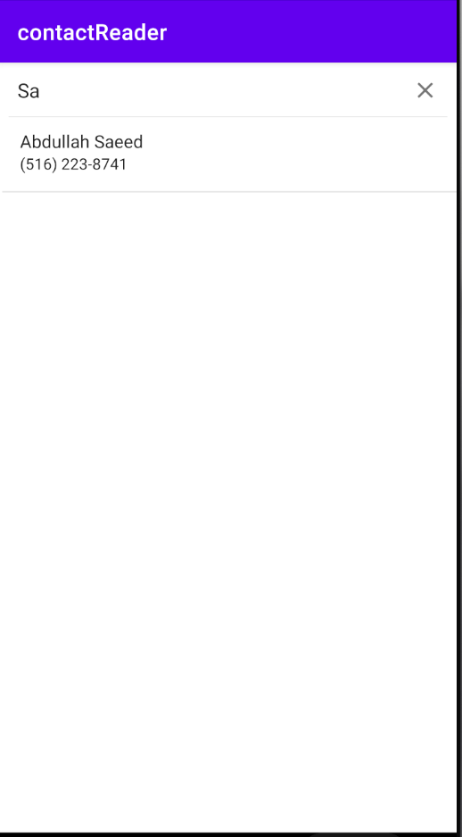
Let’s try it!

Slide 17
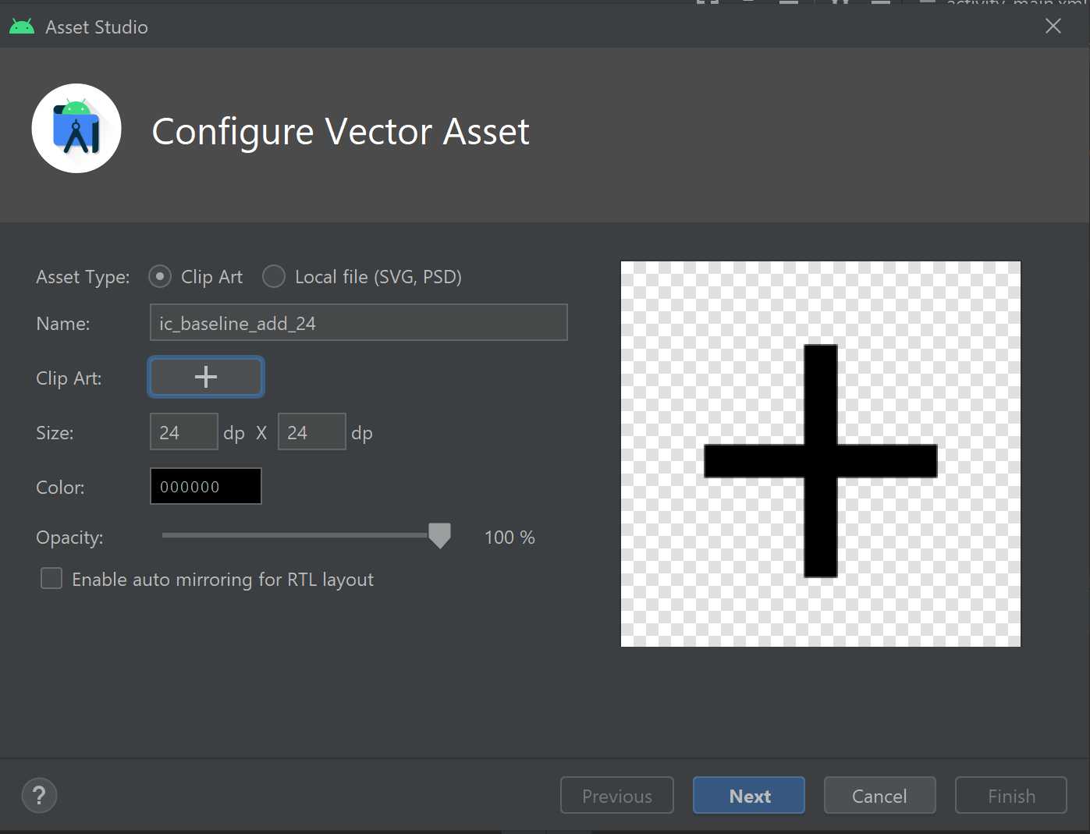
dssa

Slide 18
References
https://developer.android.com/guide/topics/providers/content-provider-basics
https://www.youtube.com/watch?v=Sxf04knGhJE
https://www.youtube.com/watch?v=-oZlj1tugLQ&t=297s

